Slide 1
Forward Kinematics

Slide 2
Links and Joints
n joints, n + 1 links
link 0 is fixed (the base)
joint i connects link i – 1 to link i
  link i moves when joint i is actuated
joint n
joint 3
joint 4
joint n-1
link 3
.................
joint 1
link 2
link n-1
link 1
link n
joint 2
link 0

Slide 3
Forward Kinematics
given the joint variables and dimensions of the links what is the position and orientation of the end effector?
p⁰ ?
a₂
θ₂
y₀
a₁
θ₁
x₀

Slide 4
Forward Kinematics
because the base frame and frame 1 have the same orientation, we can sum the coordinates to find the position of the end effector in the base frame
(a₁ cos θ₁ + a₂ cos (θ₁ + θ₂),
a₁ sin θ₁ + a₂ sin (θ₁ + θ₂) )
y₁
a₂
( a₂ cos (θ₁ + θ₂),
a₂ sin (θ₁ + θ₂) )
θ₂
y₀
θ₁
a₁
x₁
θ₁
( a₁ cos θ₁ , a₁ sin θ₁ )
x₀

Slide 5
Forward Kinematics
from earlier in the course
p⁰ = (a₁ cos θ₁ + a₂ cos (θ₁ + θ₂),
a₁ sin θ₁ + a₂ sin (θ₁ + θ₂) )
y₂
x₂
x₂ = (cos (θ₁ + θ₂),
sin (θ₁ + θ₂) )
y₂ = (-sin (θ₁ + θ₂),
cos (θ₁ + θ₂) )
a₂
θ₂
y₀
θ₁
a₁
θ₁
x₀

Slide 6
Frames
y₂
x₂
y₁
a₂
θ₂
y₀
x₁
a₁
θ₁
x₀

Slide 7
Forward Kinematics
using transformation matrices

Slide 8
Links and Joints
n joints, n + 1 links
link 0 is fixed (the base)
joint i connects link i – 1 to link i
  link i moves when joint i is actuated
joint n
joint 3
joint 4
joint n-1
link 3
.................
joint 1
link 2
link n-1
link 1
link n
joint 2
link 0

Slide 9
Forward Kinematics
attach a frame {i} to link i
  all points on link i are constant when expressed in {i}
  if joint i is actuated then frame {i} moves relative to frame {i - 1}
    motion is described by the rigid transformation
    the state of joint i is a function of its joint variable q_{i} (i.e., is a function of q_{i})
this makes it easy to find the last frame with respect to the base frame

Slide 10
Forward Kinematics
more generally
the forward kinematics problem has been reduced to matrix multiplication

Slide 11
Forward Kinematics
Denavit J and Hartenberg RS, “A kinematic notation for lower-pair mechanisms based on matrices.” Trans ASME J. Appl. Mech, 23:215–221, 1955
  described a convention for standardizing the attachment of frames on links of a serial linkage
common convention for attaching reference frames on links of a serial manipulator and computing the transformations between frames

Slide 12
Denavit-Hartenberg

Slide 13
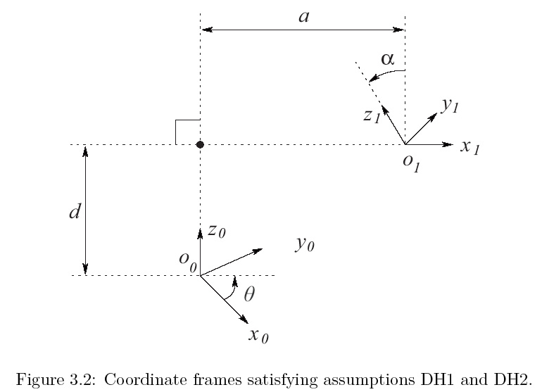
Denavit-Hartenberg

Slide 14
Denavit-Hartenberg
notice the form of the rotation component
  this does not look like it can represent arbitrary rotations
can the DH convention actually describe every physically possible link configuration?

Slide 15
Denavit-Hartenberg
yes, but we must choose the orientation and position of the frames in a certain way
  (DH1)
  (DH2)
claim: if DH1 and DH2 are true then there exists unique numbers

Slide 16
Denavit-Hartenberg
proof: on blackboard in class

Slide 17
Denavit-Hartenberg

Slide 18
DH Parameters
a_{i} : link length
  distance between z_{i-1} and z_{i} measured along x_{i}
α_{i} : link twist
  angle between z_{i-1} and z_{i} measured about x_{i}
d_{i} : link offset
  distance between o_{i-1} to the intersection of x_{i} and z_{i-1} measured along z_{i-1}
θ_{i} : joint angle
  angle between x_{i-1} and x_{i} measured about z_{i-1}

Slide 19
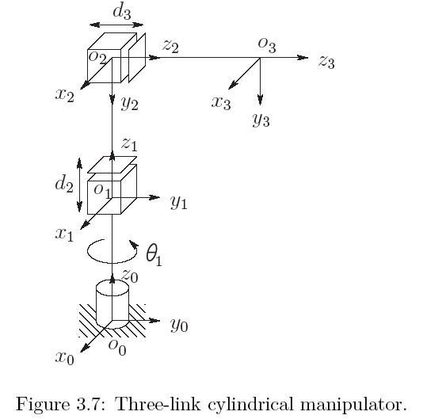
Example with Frames Already Placed

Slide 20
Step 5: Find the DH parameters
Link | a_{i} | α_{i} | d_{i} | θ_{i}
1 | 0 | 0 | d₁ | θ₁*
2 | 0 | -90 | d₂* | 0
3 | 0 | 0 | d₃* | 0
* joint variable

Slide 21
Denavit-Hartenberg Forward Kinematics
RPP cylindrical manipulator
    http://strobotics.com/cylindrical-format-robot.htm

Slide 22
Denavit-Hartenberg Forward Kinematics
How do we place the frames?

Slide 23
Step 1: Choose the z-axis for each frame
recall the DH transformation matrix

Slide 24
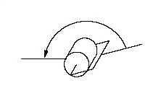
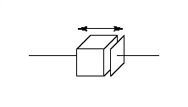
Step 1: Choose the z-axis for each frame
axis of actuation for joint i+1
link i
link i+1
link i
link i+1
joint i+1
joint i+1

Slide 25
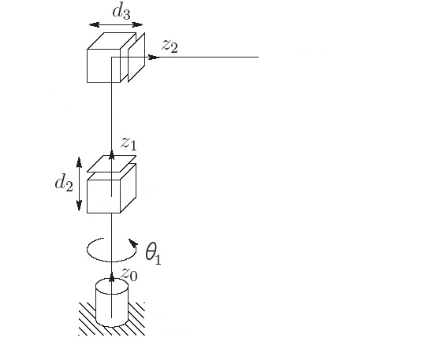
Step 1: Choose the z-axis for each frame
    Warning: the picture is deceiving. We do not yet know the origin of the frames; all we know at this point is that each z_{i} points along a joint axis

Slide 26
Step 2: Establish frame {0}
place the origin o₀ anywhere on z₀
  often the choice of location is obvious
choose x₀ and y₀ so that {0} is right-handed
  often the choice of directions is obvious

Slide 27
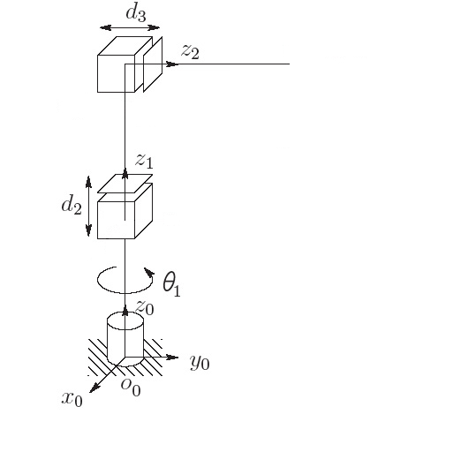
Step 2: Establish frame {0}

Slide 28
Step 3: Iteratively construct {1}, {2}, ... {n-1}
using frame {i-1} construct frame {i}
  DH1: x_{i} is perpendicular to z_{i-1}
  DH2: x_{i} intersects z_{i-1}
3 cases to consider depending on the relationship between z_{i-1} and z_{i}

Slide 29
Step 3: Iteratively construct {1}, {2}, ... {n-1}
Case 1
  z_{i-1} and z_{i} are not coplanar (skew)
  α_{i} angle from z_{i-1} to z_{i} measured about x_{i}
shortest line between
and
(out of page)
point of intersection

Slide 30
Step 3: Iteratively construct {1}, {2}, ... {n-1}
Case 2
  z_{i-1} and z_{i} are parallel ( α_{i} = 0 )
  notice that this choice results in d_{i} = 0
point of intersection

Slide 31
Step 3: Iteratively construct {1}, {2}, ... {n-1}
Case 3
  z_{i-1} and z_{i} intersect ( a_{i} = 0 )
point of intersection
(out of page)

Slide 32
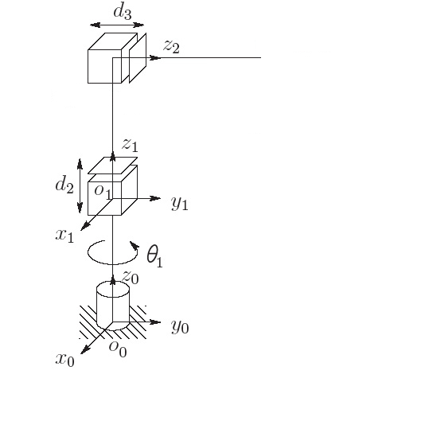
Step 3: Iteratively construct {1}, {2}, ... {n-1}

Slide 33
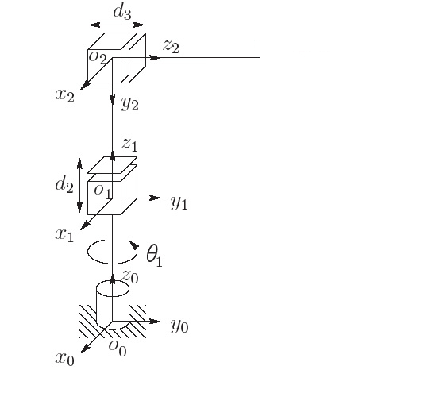
Step 3: Iteratively construct {1}, {2}, ... {n-1}

Slide 34
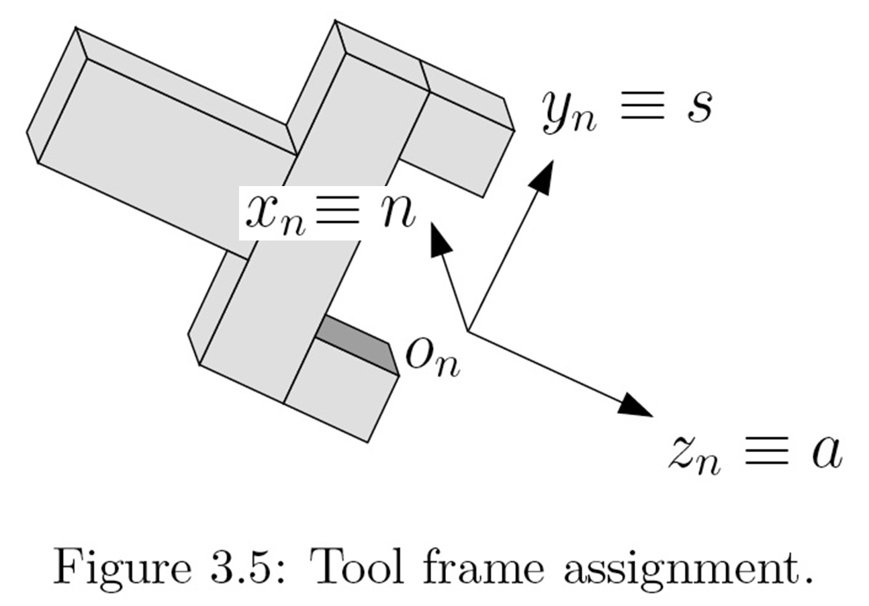
Step 4: Place the end effector frame
“sliding”
“normal”
“approach”

Slide 35
Step 4: Place the end effector frame

Slide 36
Step 5: Find the DH parameters
a_{i} : distance between z_{i-1} and z_{i} measured along x_{i}
α_{i} : angle between z_{i-1} and z_{i} measured about x_{i}
d_{i} : distance between o_{i-1} to the intersection of x_{i} and z_{i-1} measured along z_{i-1}
θ_{i} : angle between x_{i-1} and x_{i} measured about z_{i-1}

Slide 37
Step 5: Find the DH parameters
Link | a_{i} | α_{i} | d_{i} | θ_{i}
1 | 0 | 0 | d₁ | θ₁*
2 | 0 | -90 | d₂* | 0
3 | 0 | 0 | d₃* | 0
* joint variable

Slide 38
More Denavit-Hartenberg Examples

Slide 39
Step 5: Find the DH parameters
Link | a_{i} | α_{i} | d_{i} | θ_{i}
1 | 0 | 0 | d₁ | θ₁*
2 | 0 | -90 | d₂* | 0
3 | 0 | 0 | d₃* | 0
* joint variable

Slide 40
Step 6: Compute the transformation
once the DH parameters are known, it is easy to construct the overall transformation
Link | a_{i} | α_{i} | d_{i} | θ_{i}
1 | 0 | 0 | d₁ | θ₁*
2 | 0 | -90 | d₂* | 0
3 | 0 | 0 | d₃* | 0
* joint variable

Slide 41
Step 6: Compute the transformation
Link | a_{i} | α_{i} | d_{i} | θ_{i}
1 | 0 | 0 | d₁ | θ₁*
2 | 0 | -90 | d₂* | 0
3 | 0 | 0 | d₃* | 0
* joint variable

Slide 42
Step 6: Compute the transformation
Link | a_{i} | α_{i} | d_{i} | θ_{i}
1 | 0 | 0 | d₁ | θ₁*
2 | 0 | -90 | d₂* | 0
3 | 0 | 0 | d₃* | 0
* joint variable

Slide 43
Step 6: Compute the transformation

Slide 44
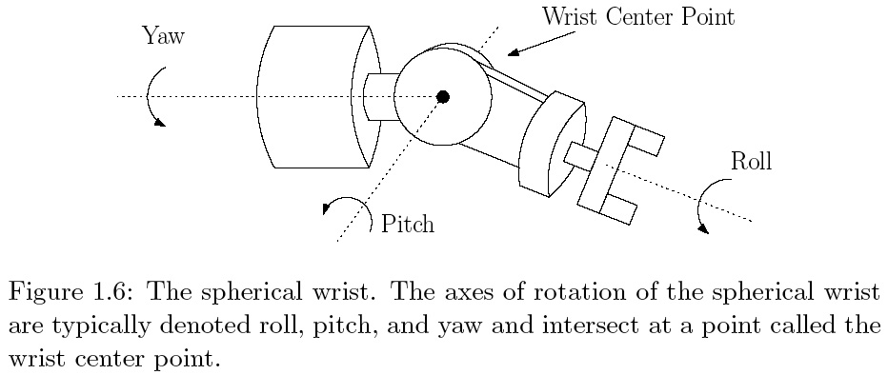
Spherical Wrist

Slide 45
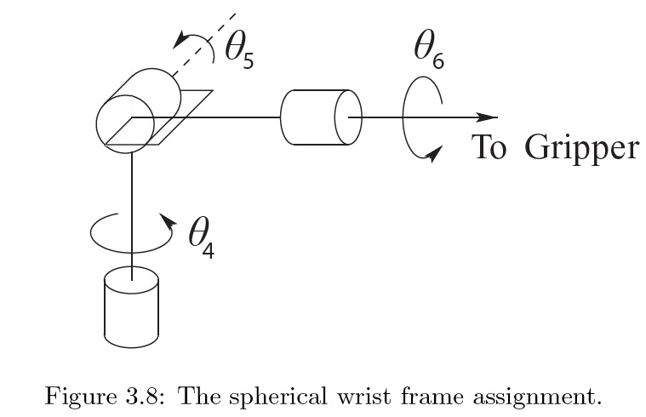
Spherical Wrist

Slide 46
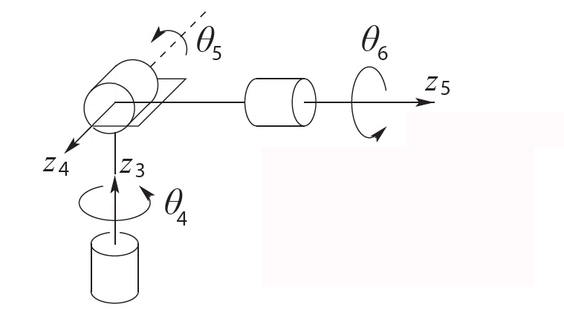
Spherical Wrist: Step 1

Slide 47
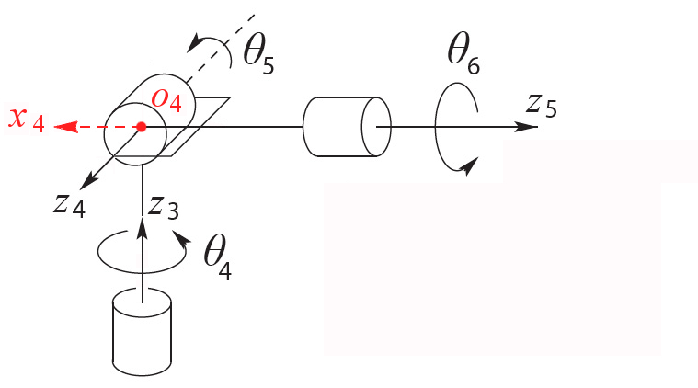
Spherical Wrist: Step 2

Slide 48
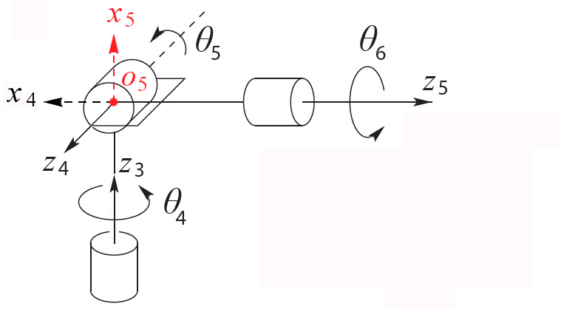
Spherical Wrist: Step 2

Slide 49
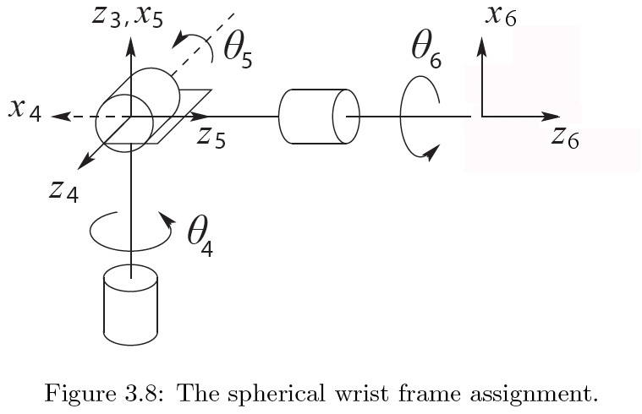
Spherical Wrist: Step 4

Slide 50
Step 5: DH Parameters
Link | a_{i} | α_{i} | d_{i} | θ_{i}
4 | 0 | -90 | 0 | θ₄*
5 | 0 | 90 | 0 | θ₅*
6 | 0 | 0 | d₆ | θ₆*
* joint variable

Slide 51
Step 6: Compute the transformation

Slide 52
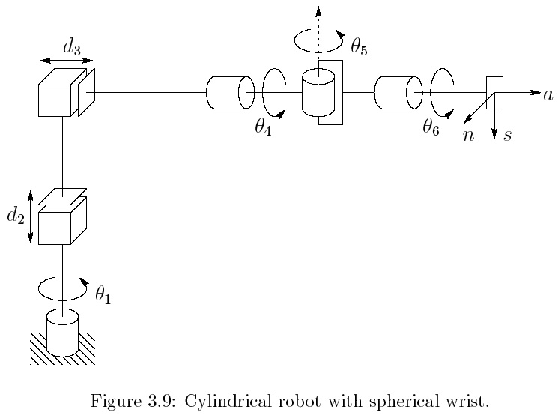
RPP + Spherical Wrist

Slide 53
RPP + Spherical Wrist

Slide 54
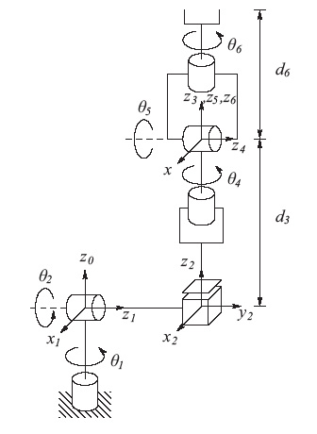
Stanford Manipulator + Spherical Wrist
Link | a_{i} | α_{i} | d_{i} | θ_{i}
1 | 0 | -90 | 0 | θ₁*
2 | 0 | 90 | d₂ | θ₂*
3 | 0 | 0 | d₃* | 0
4 | 0 | -90 | 0 | θ₄*
5 | 0 | 90 | 0 | θ₅*
6 | 0 | 0 | d₆ | θ₆*
* joint variable

Slide 55
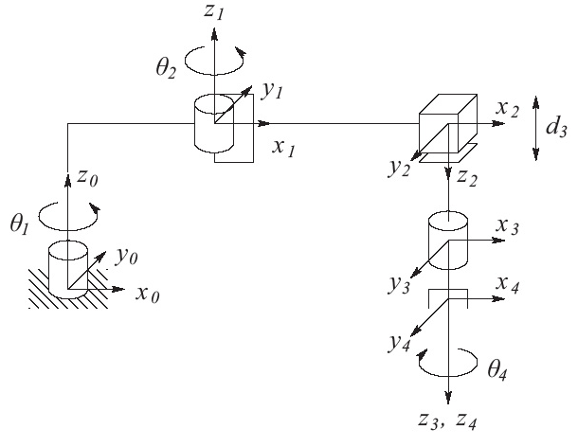
SCARA + 1DOF Wrist
Link | a_{i} | α_{i} | d_{i} | θ_{i}
1 | a₁ | 0 | d₁ | θ₁*
2 | a₂ | 180 | 0 | θ₂*
3 | 0 | 0 | d₃* | 0
4 | 0 | 0 | d₄ | θ₄*
* joint variable

